Slide 1
DPM Meeting 4
Component Testing

Slide 2
Gantt Chart

Slide 3
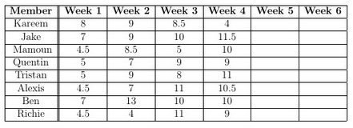
Budget
Week 4:
Kareem
Updated Gantt Chart
Worked with the Software Team
Jake
Worked on LDD model
Wrote up the Localization Test for Hardware Version 1.5
Started Poster
Helped test out Hardware Version 2.5
Helped test Navigation/Odometry
Tristan & Alexis:
Set up of the software
Wrote the localization and navigation code
Wrote and generated the JavaDocs of the code
Mamoun & Richie:
Tested Navigation/Odometry for Hardware Version 2.5 and 2.55
Quentin & Ben:
Built two more versions of the robot
Tested Navigation/Odometry and Discontinuities for Hardware Version 2.5 and 2.55

Slide 4
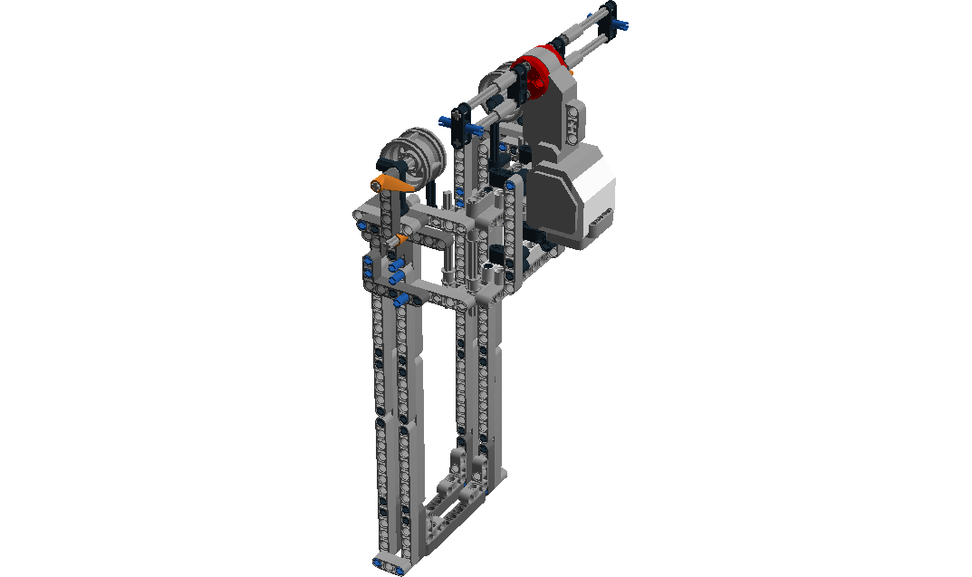
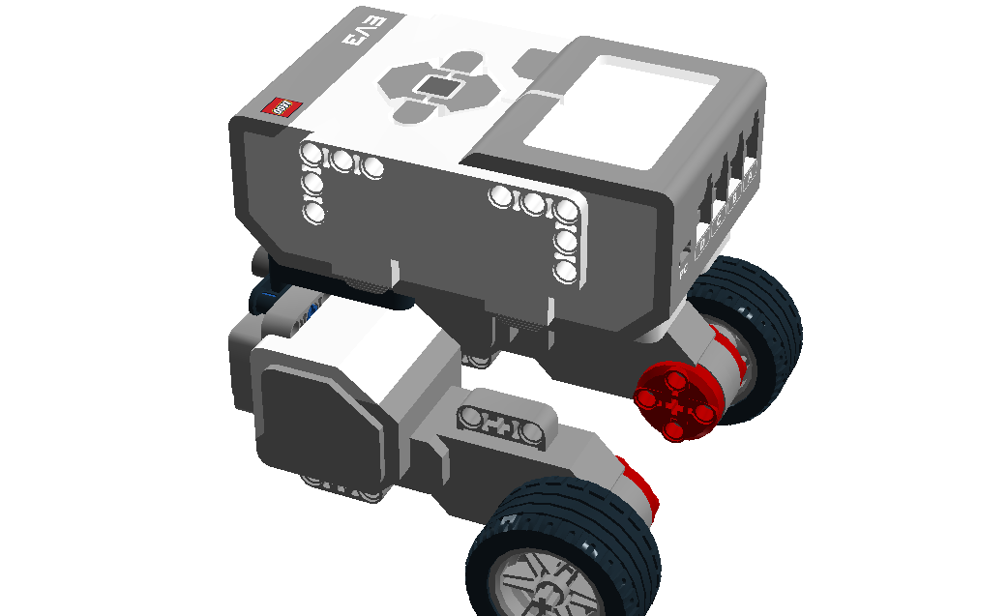
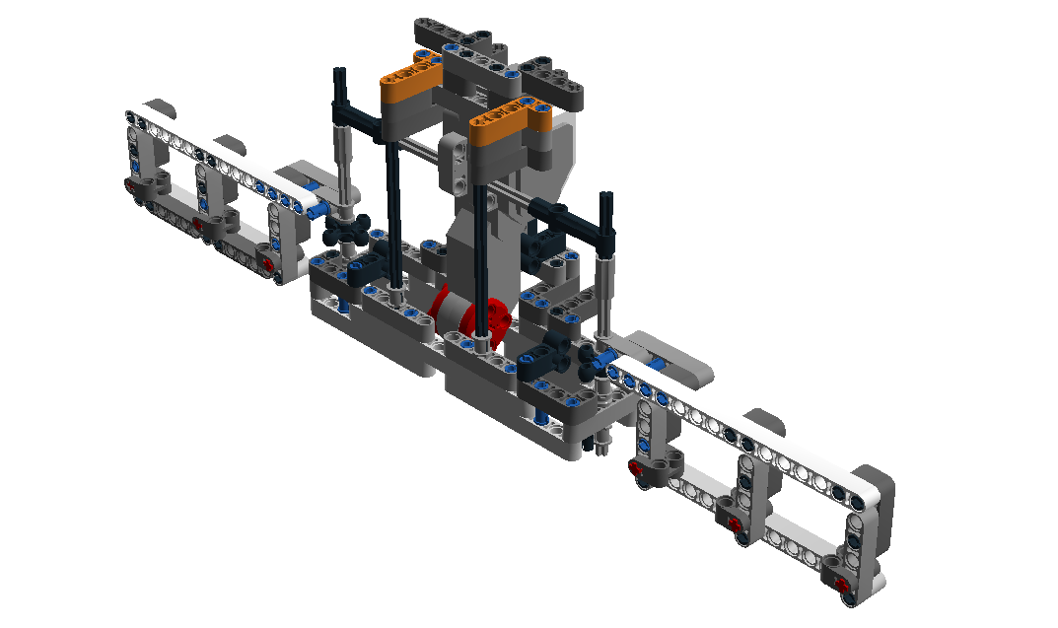
Documentation
Lego Digital Designer
Chassis may change, so that was put on hold
The intricate designs took some time to implement on Lego Digital Designer.

Slide 5
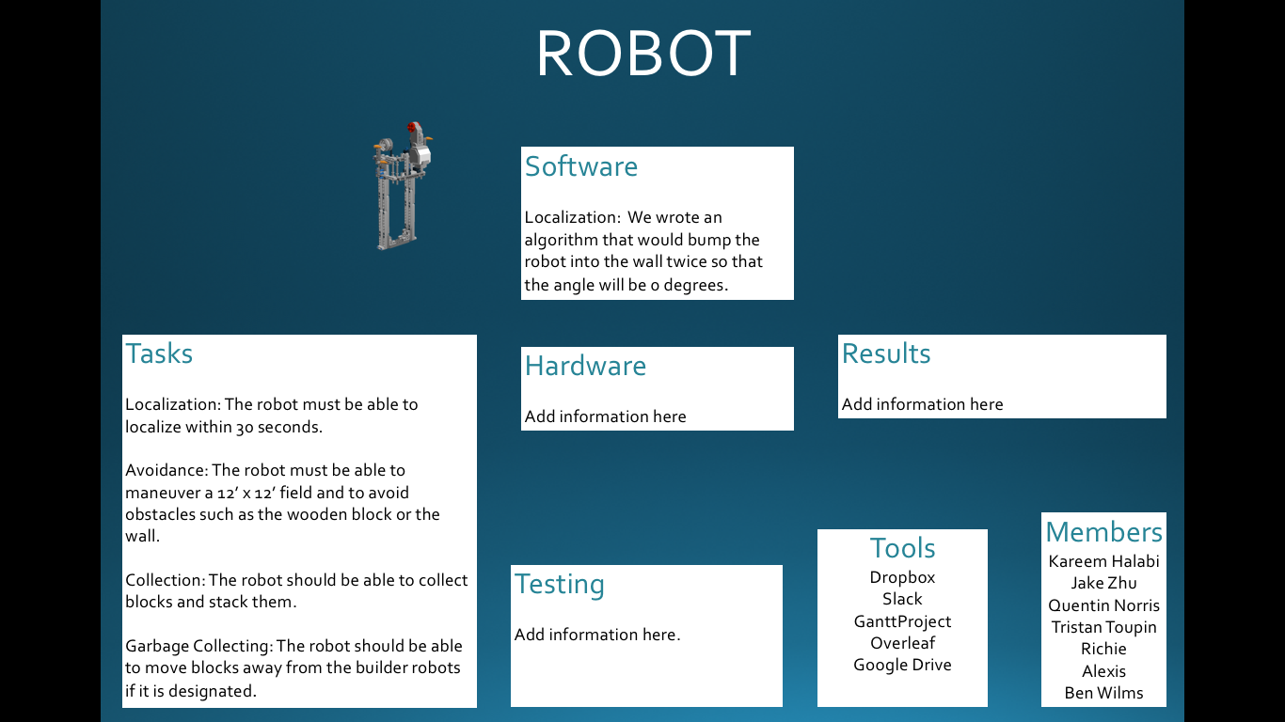
Poster
Started brainstorming ideas for the final poster design
We will be using Microsoft PowerPoint in to design it

Slide 6
Software
API
Localization progressing but some issues still need to be resolved
Implemented Logging framework for LCD display and file output
Navigation and Object Collection will be finished this week
Started working on JavaDocs (new and reused classes)
JavaDocs will be added as classes become more finalized

Slide 7
Hardware
Version 1.5
Stabilizers were added to the top of the grabbing mechanism
Tower moved closer to main chassis
Version 2.0
Chassis rebuilt for balance issues
Rear Wheel Drive was added
Version 2.5
Gears were changed to the 4-prong gears
Version 2.55
Tried using a spoon glued onto the ball bearing

Slide 8
Testing
Localization
Balance issues on version 1.5
Navigation/Odometry
Tested the version 2.5 to find constants
Tested to find the error with Navigation/Odometry
Discontinuities
The robot was run at specific angles to see if it could overcome discontinuities

Slide 9
Plan for Next Week
Finishing Localization and other software components
Component and integration testing
Beta Demo on Friday!

